Slide 1





i.)Interview and Survey Results
ii.)What is Rebooked?
iii.)Scenario and Persona
iv.)Functionalities
v.) Heuristics
vi.) Application Screenshots
vii.) Summary

Slide 2
Interview Results
During the planning and design phase of our application Rebooked, we asked questions about the experiences of users using second-hand products and supported the results with charts.
As a result of these surveys, we discovered the need for our surveyors to also trade products through barter without spending a lot of money. Since the demands for second-hand applications are also intense, we immediately added this feature to our application.

Slide 3
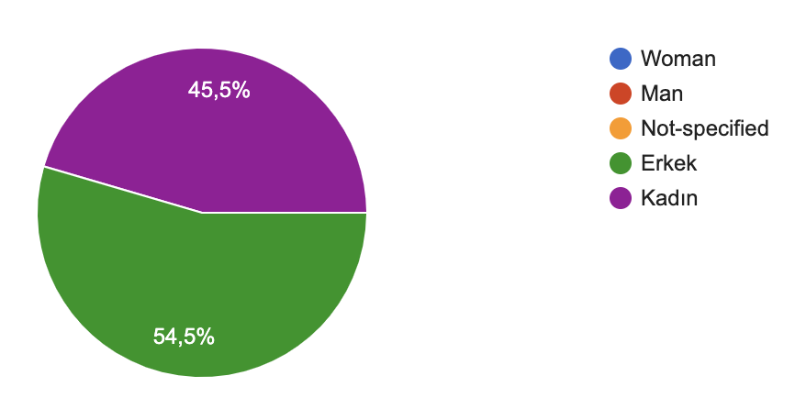
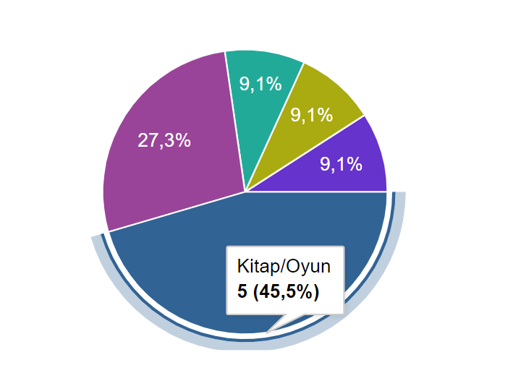
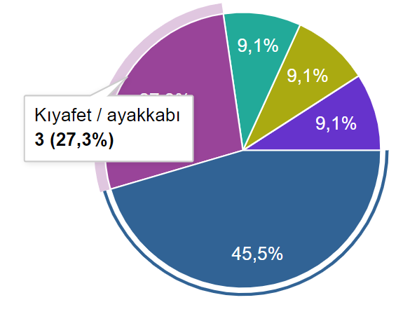
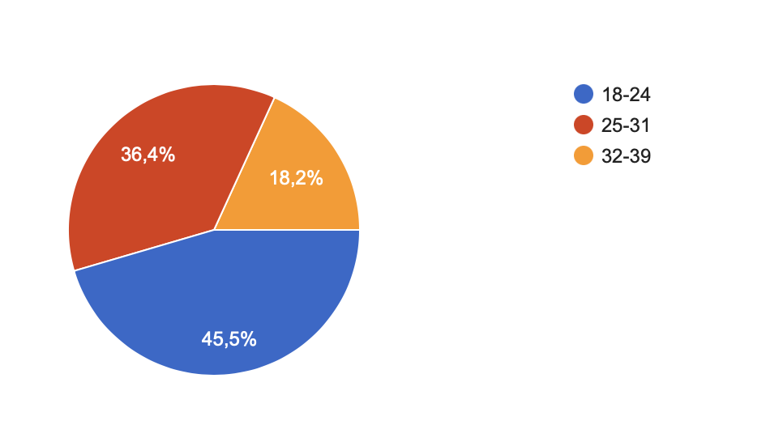
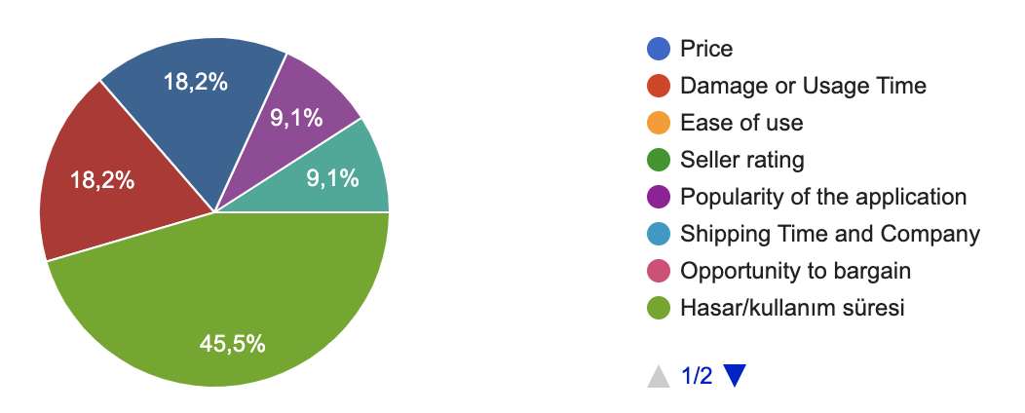



Survey Results about Second-Hand Applications
1.Gender
3. What items do you buy second-hand?
2. Age
4. Which criteria do you care most in second-hand?

Slide 4
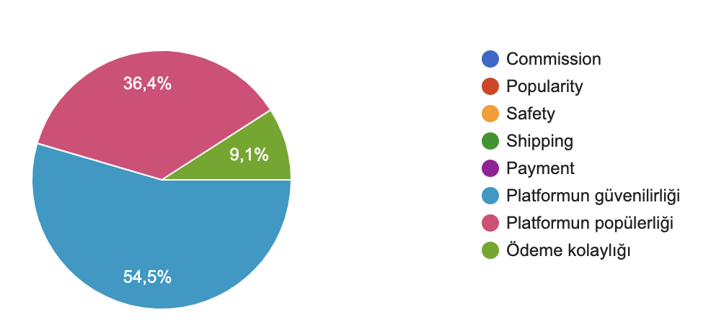
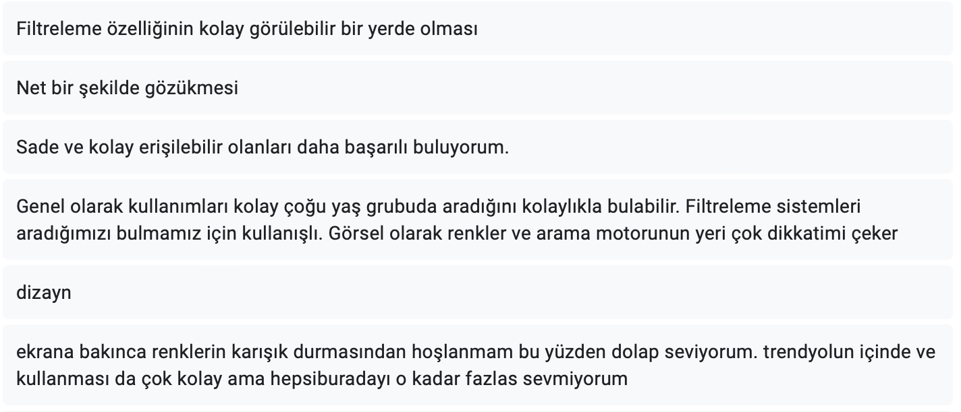
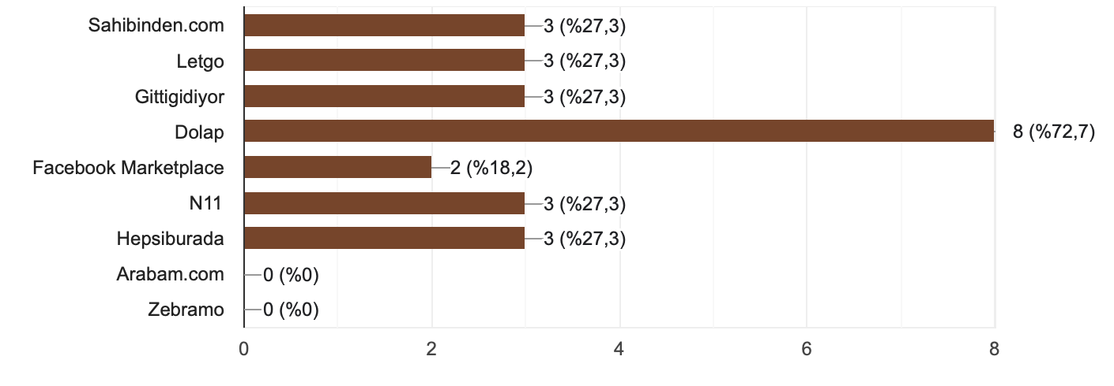



Survey Results about Second-Hand Applications
5. If you want to sell second-hand products on website, which you give the most importance to?
7.What do you think about the interface of second-hand app? What is the most visually striking thing?
6.Did you download/enter any of the applications below and have a look? Select them.
Q.8 user demands: Having a easy filtering feature, the contents and buttons can be seen clearly, the design is simple, easy, suitable for target age groups, color harmony when looking at the design screen, not confusing.
Q-9 user's favorite app: sahibinden.com, Dolap, Instagram Market and Trendyol

Slide 5

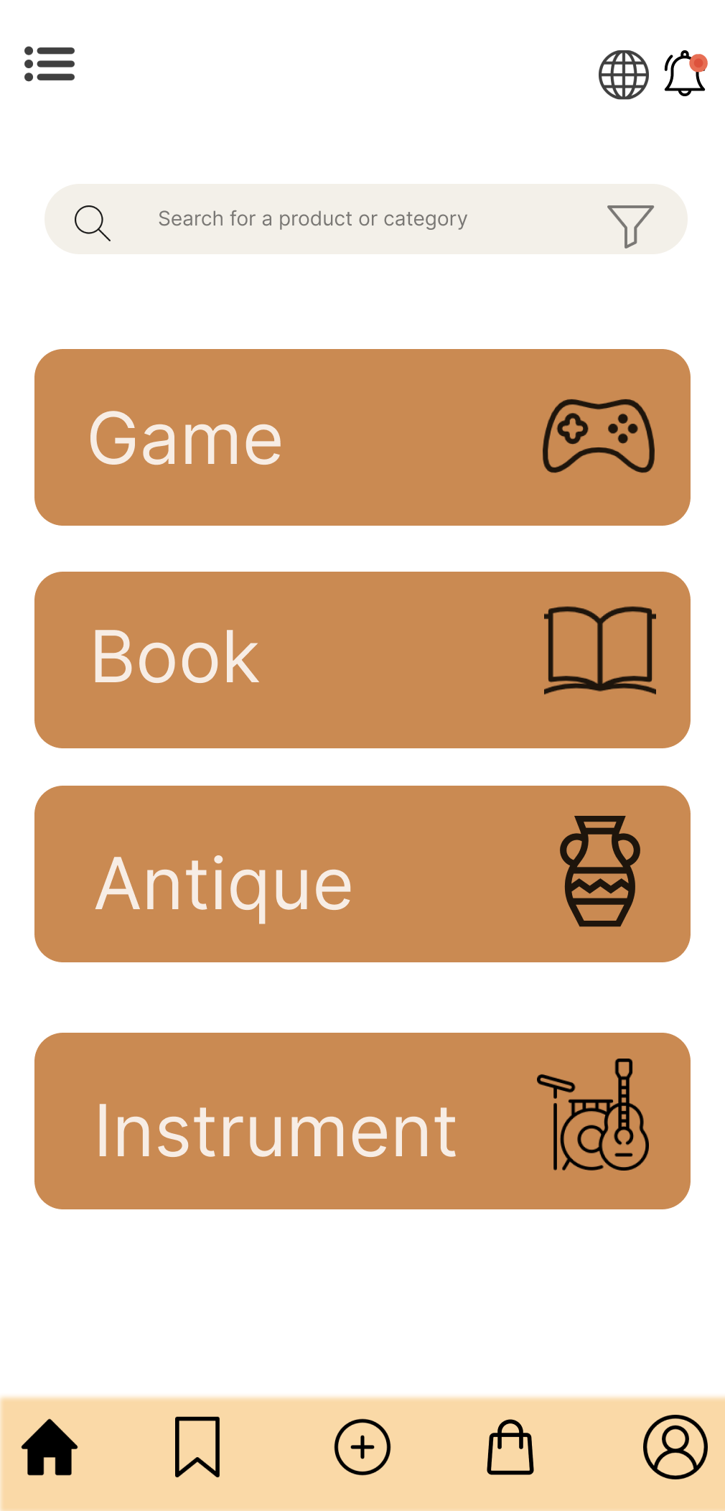
What is Rebooked?
Rebooked is a second-hand application that offers special prices to its members, where users can buy, sell or trade games, books, antiques and instruments. It is free to become a member of the Rebooked application.

Slide 6
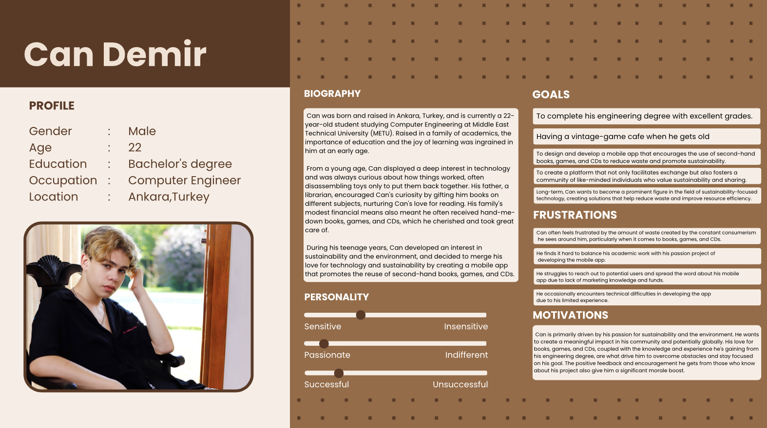
Persona : Can Demir

Slide 7

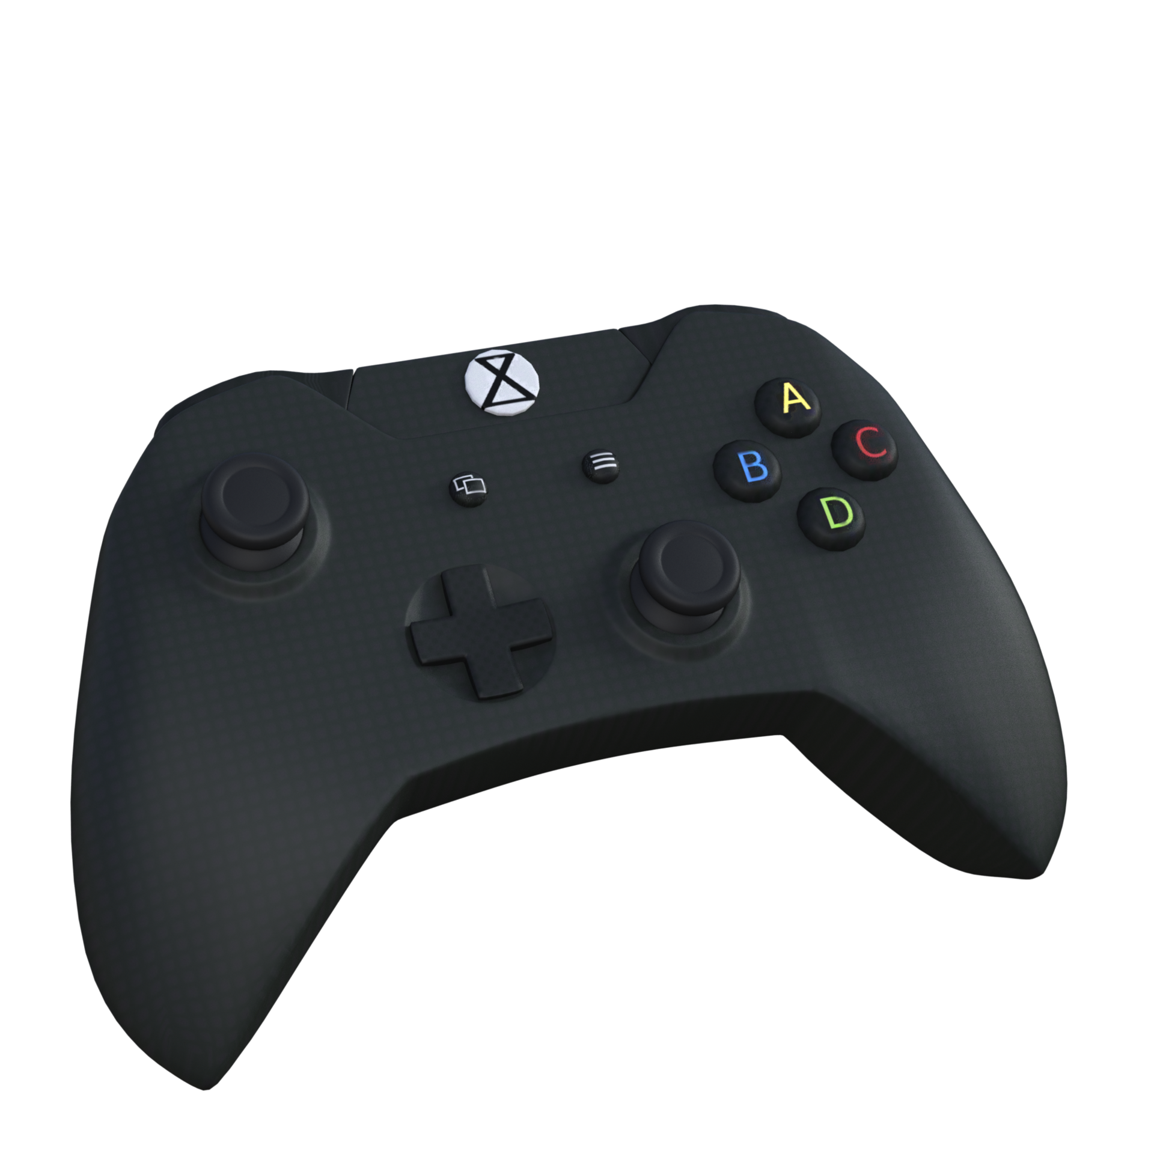
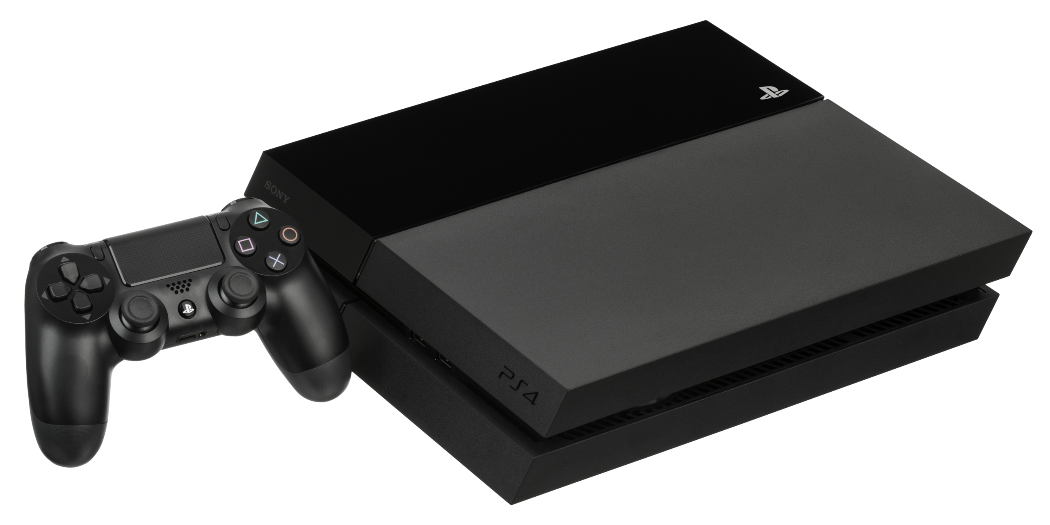
The Scenario of the Application
Can is an individual who cares about sustainability, has a tight budget, and has a girlfriend with refined tastes such as an upcoming collection of antique books and playing original game consoles. He needed an application that was both budget-friendly and focused on sustainability, selling second-hand products. After his girlfriend searches for the first edition of the book "Pride and Prejudice", Can will be able to easily find what he is looking for with the filtering feature of the application. Can is not only a buyer, but also obtains the cost of the book "Pride and Prejudice" by selling the books he has never touched.

Slide 8
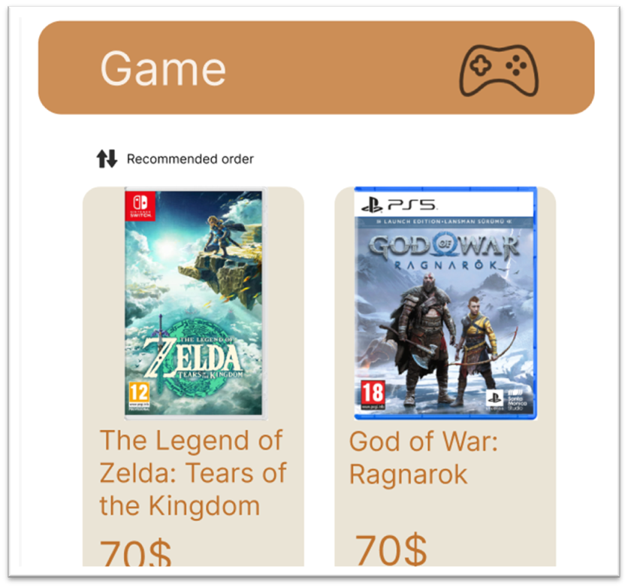
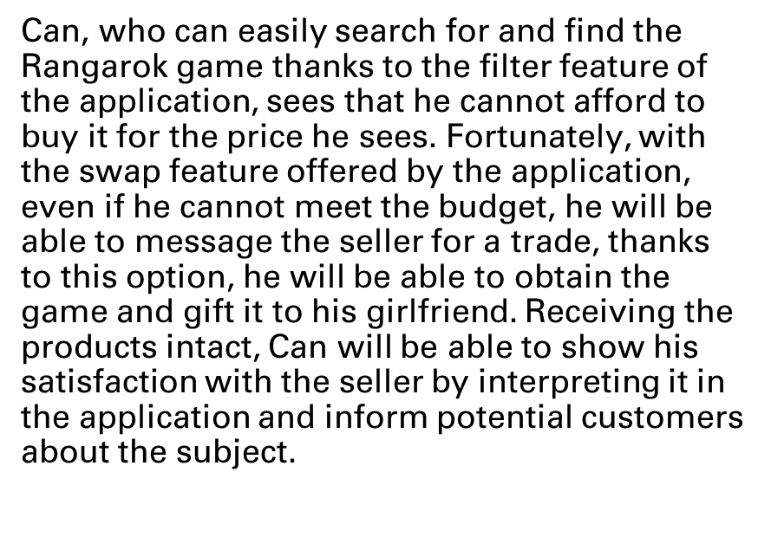
The Scenario of the Application

Slide 9
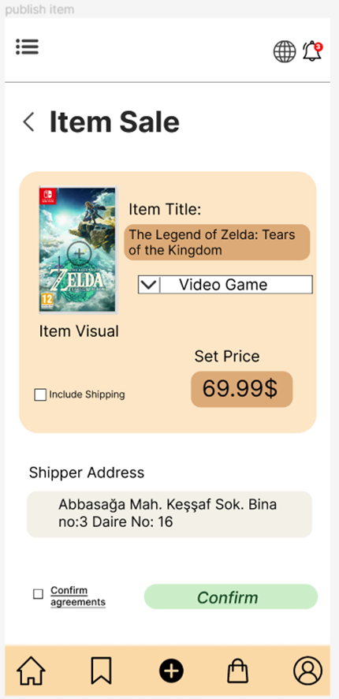
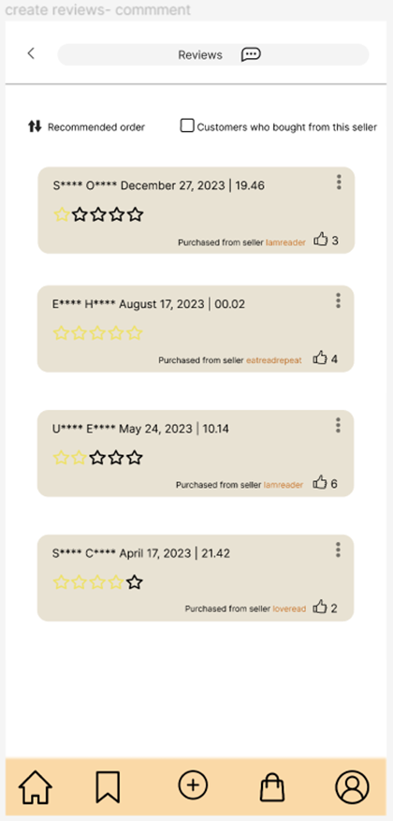
Primary Functionalities
REVIEW
PUBLISH
Those who want to sell in the application can publish items
After entering detailed information about the product, the product is put into practice by "confirm".
Users can evaluate the second-hand products they bought from the application by leaving a comment after receiving them.
We can inform customers who have not placed an order from the application before, with their comments.
Sellers' confidence score is built on reviews and ratings.

Slide 10
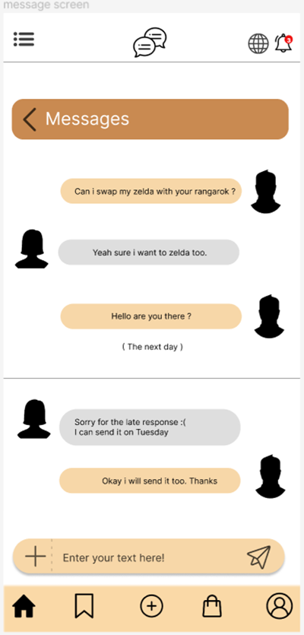
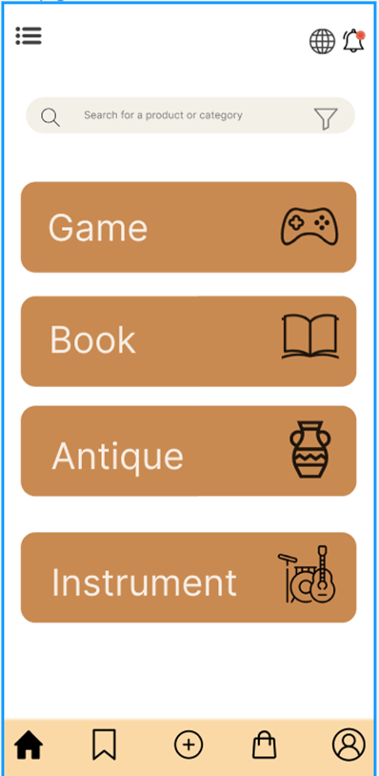
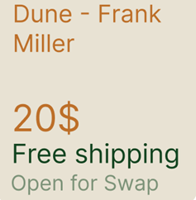
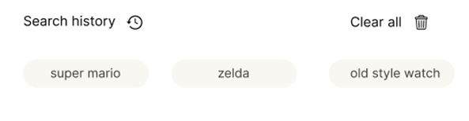
Primary Functionalities
SWAP(additional)
FILTER
In our application, users can trade their products by negotiating via messages.
Some items in the app are open to trade
Users notify trade offers via message
Agreement can be made in the Messages section.
Users can easily find the product they want by using the filter feature of our application while searching for products.
It becomes easier to search for products not only by searching, but also by choosing the filters offered by the application.

Slide 11
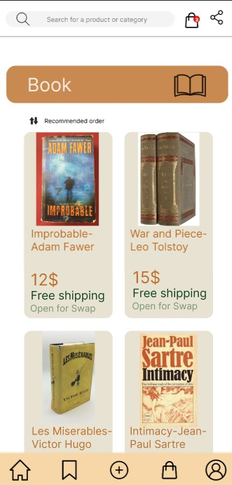
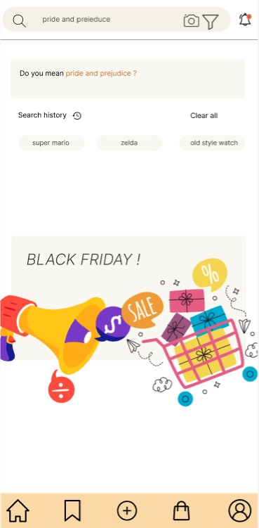
Usability Problems with Nielsen’s Heuristic
During the test process, when the application was interpreted according to Nielsen's Heuristic methods, 5 usability problems were determined in the first stage. We present to you previous and revised versions of these usability problems.

Slide 12
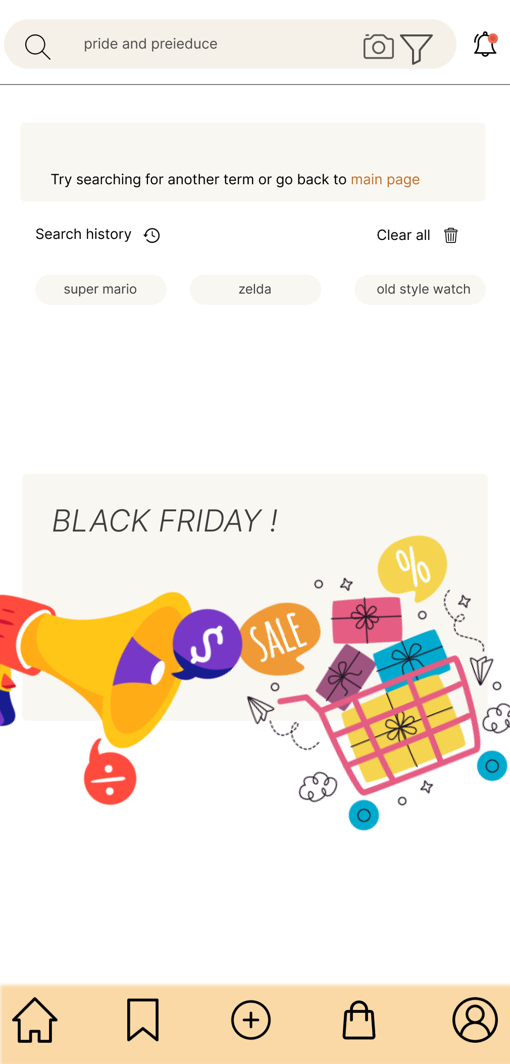
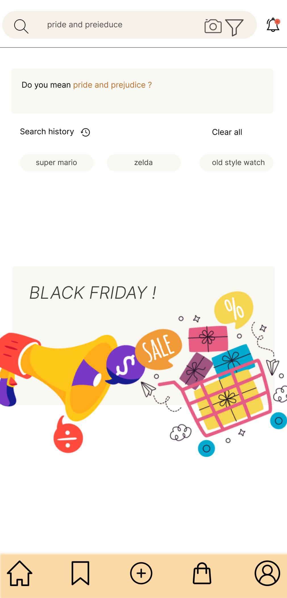
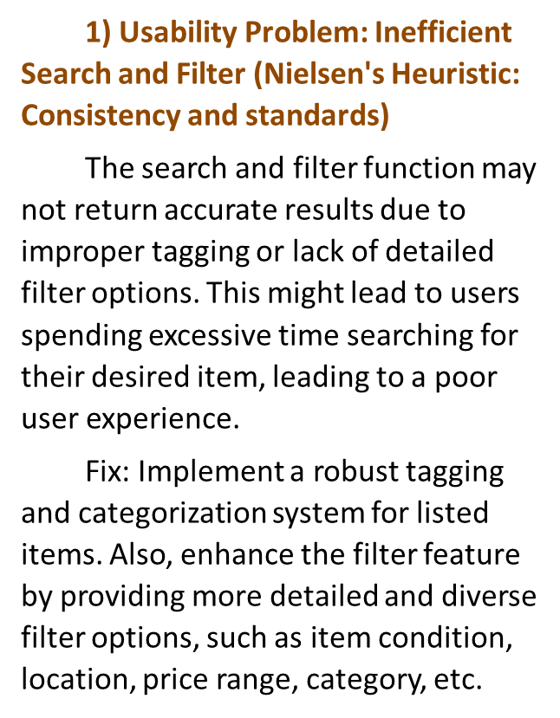
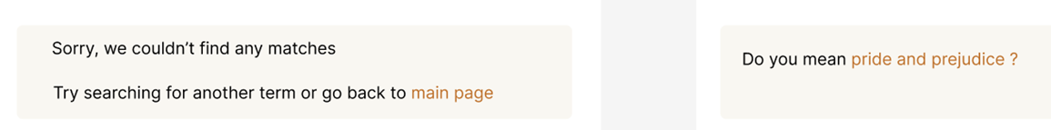
Search Filter
Search Filter - revised

Slide 13
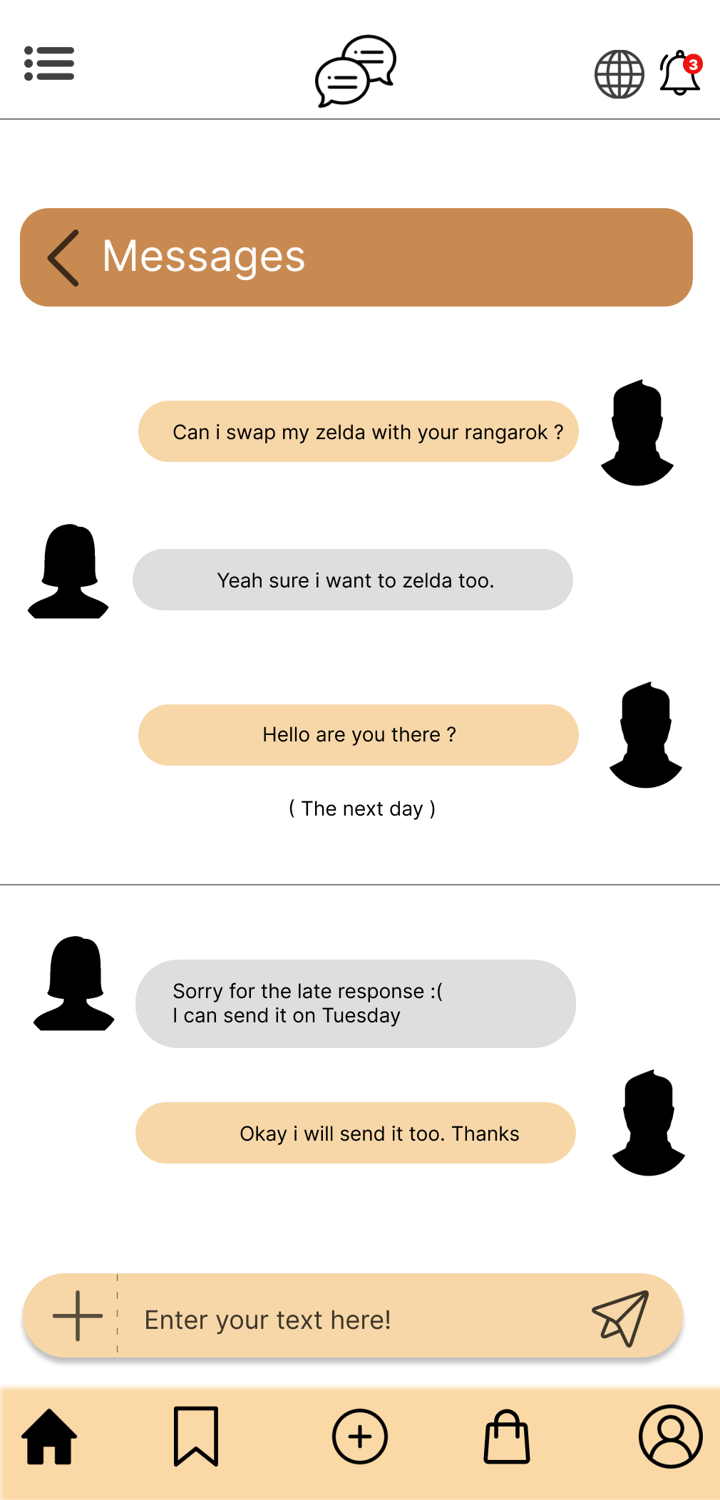
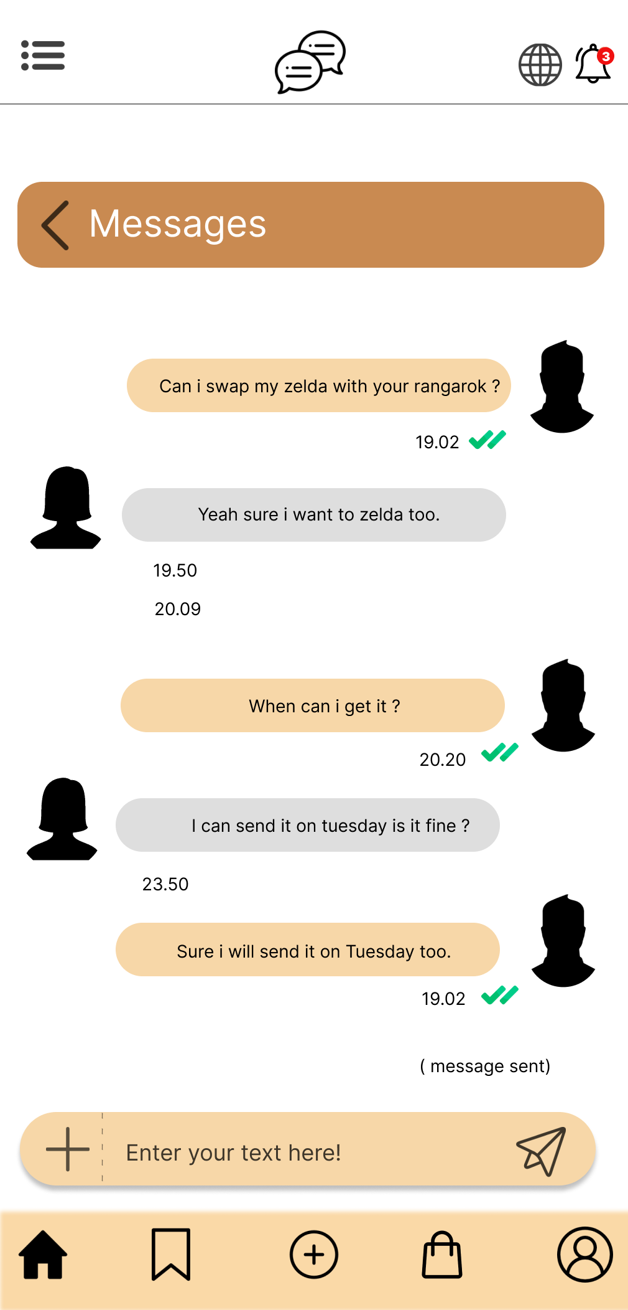
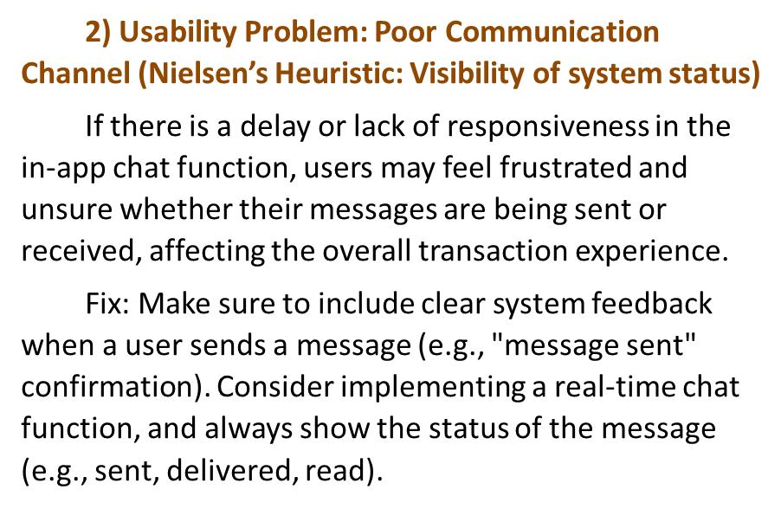
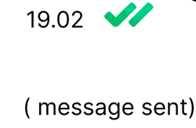
Message Screen
Message Screen- revised

Slide 14
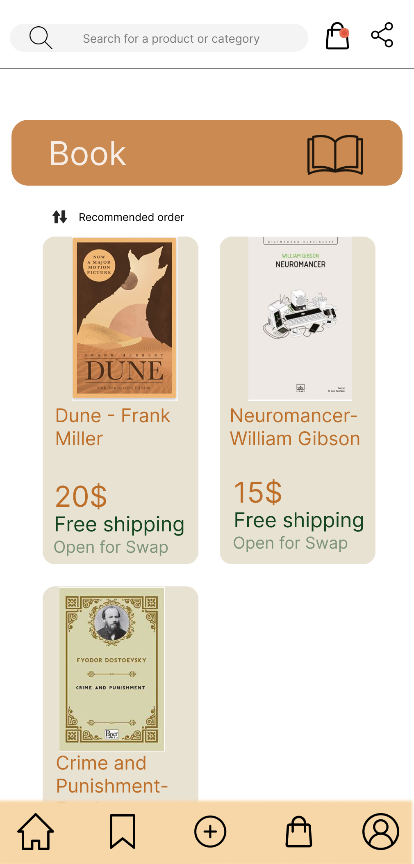
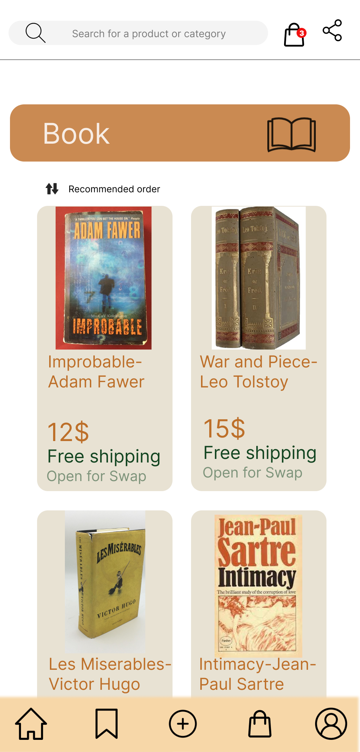

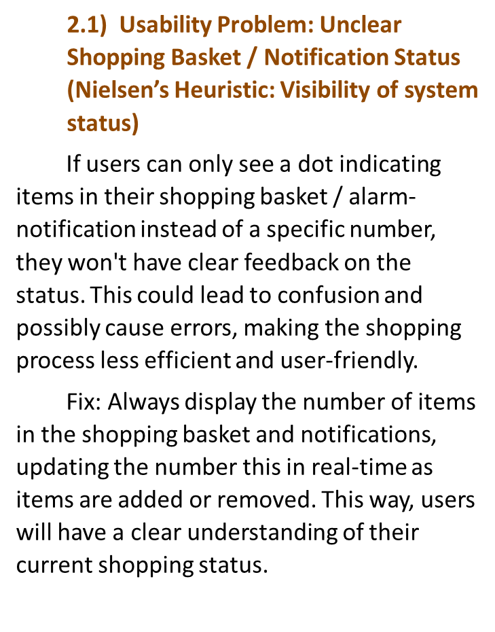



Shopping basket
Shopping basket - revised

Slide 15
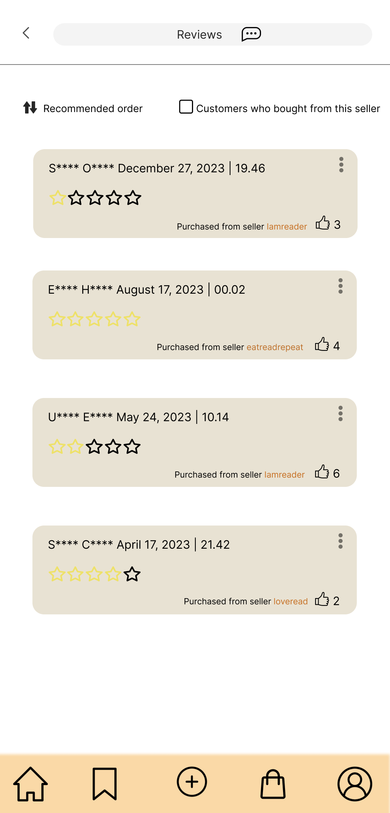
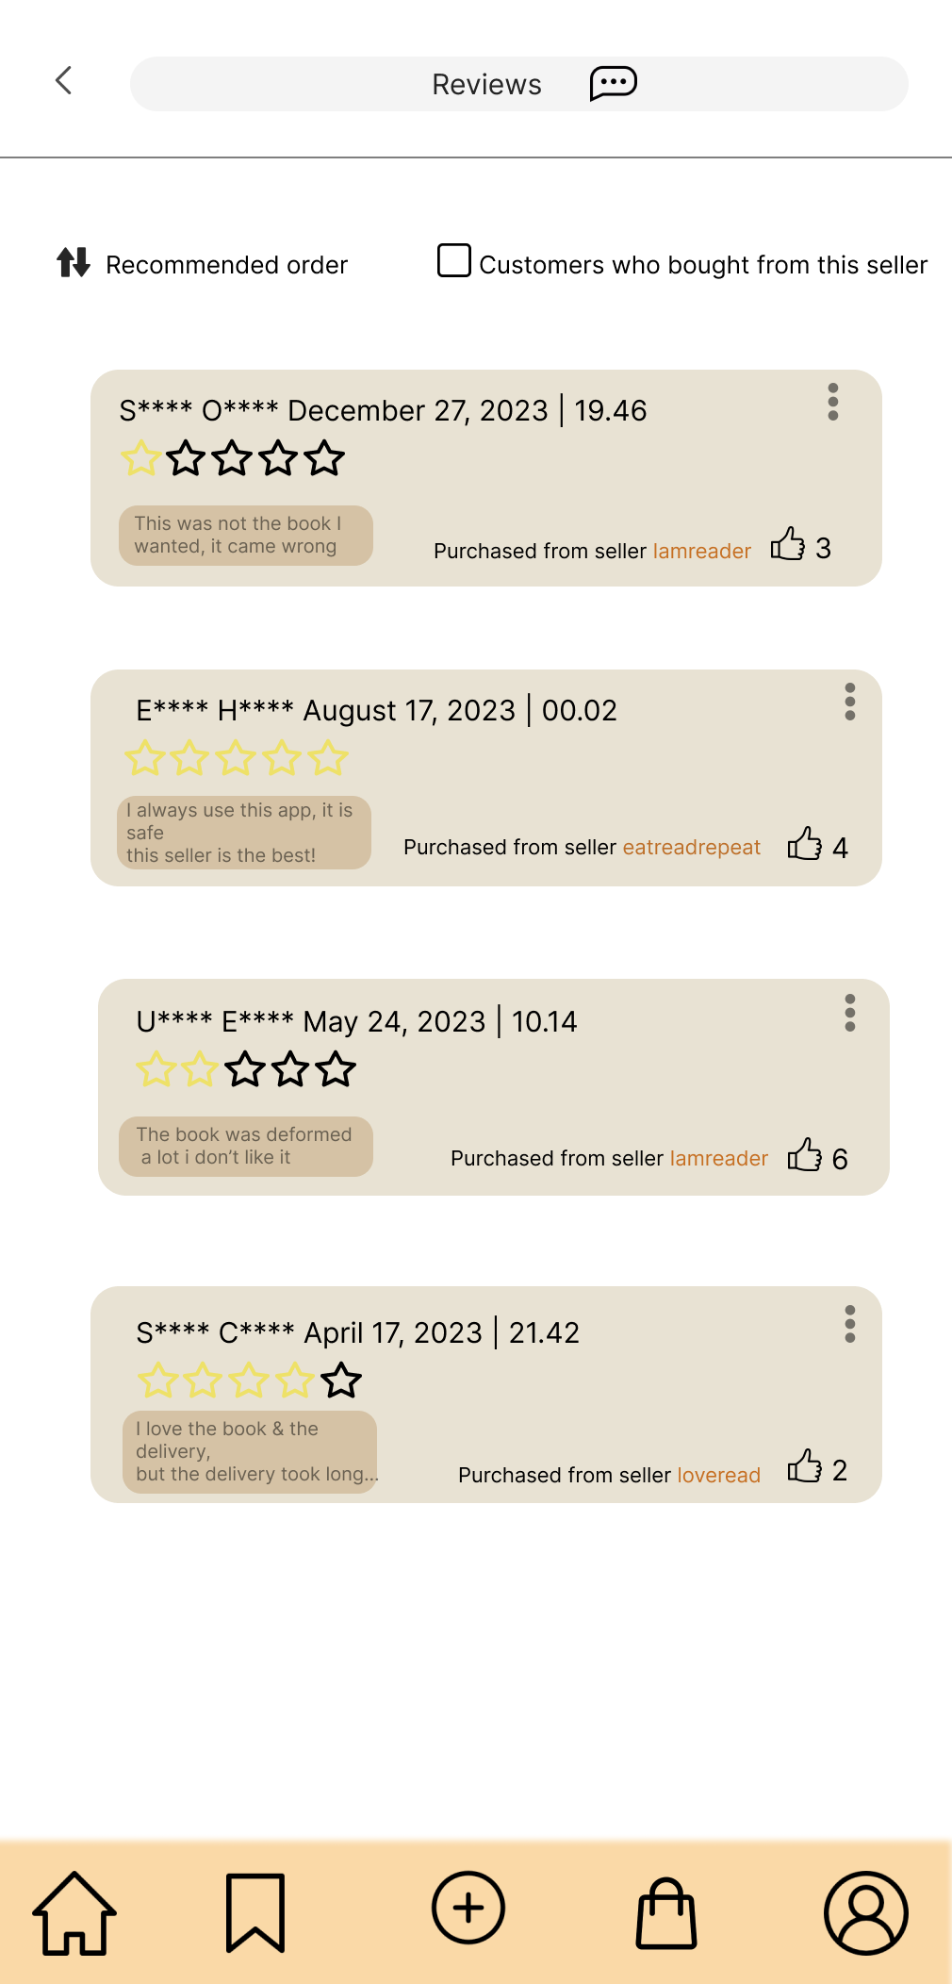
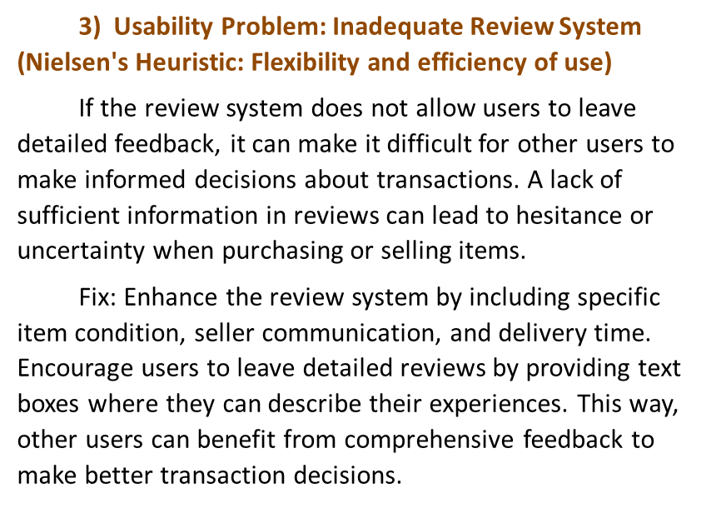
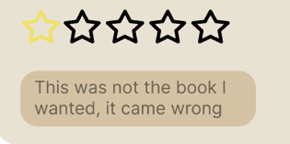
Review Screen
Review Screen- revised

Slide 16
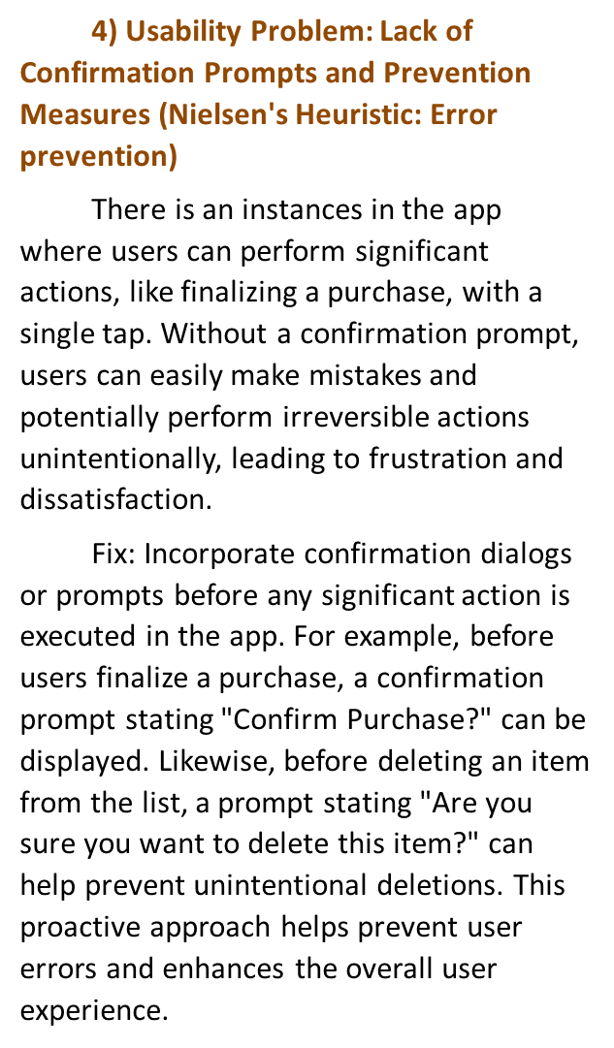
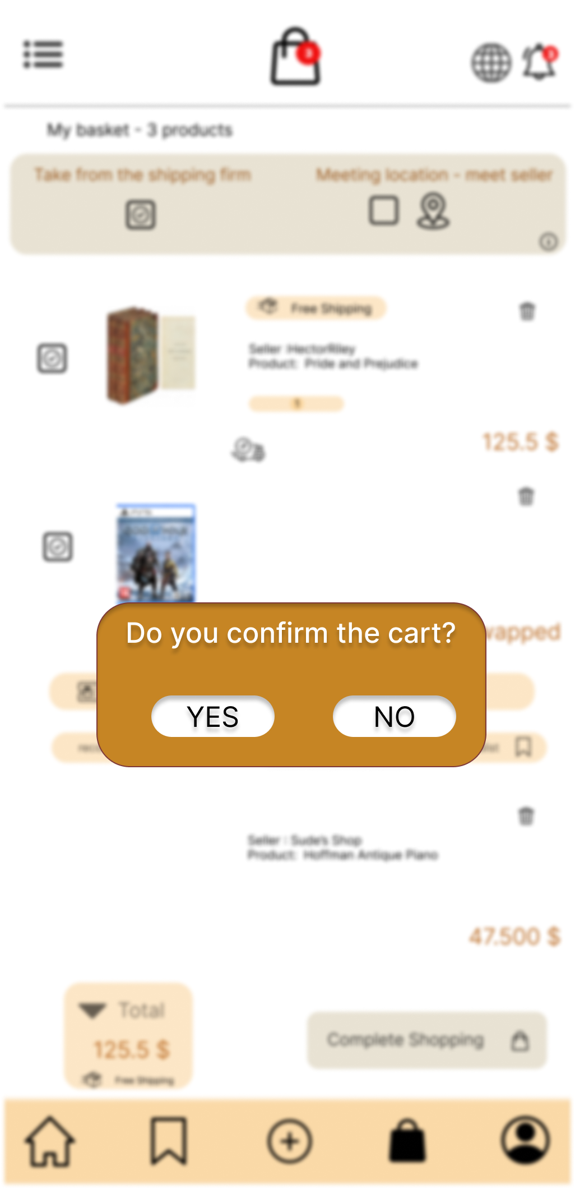
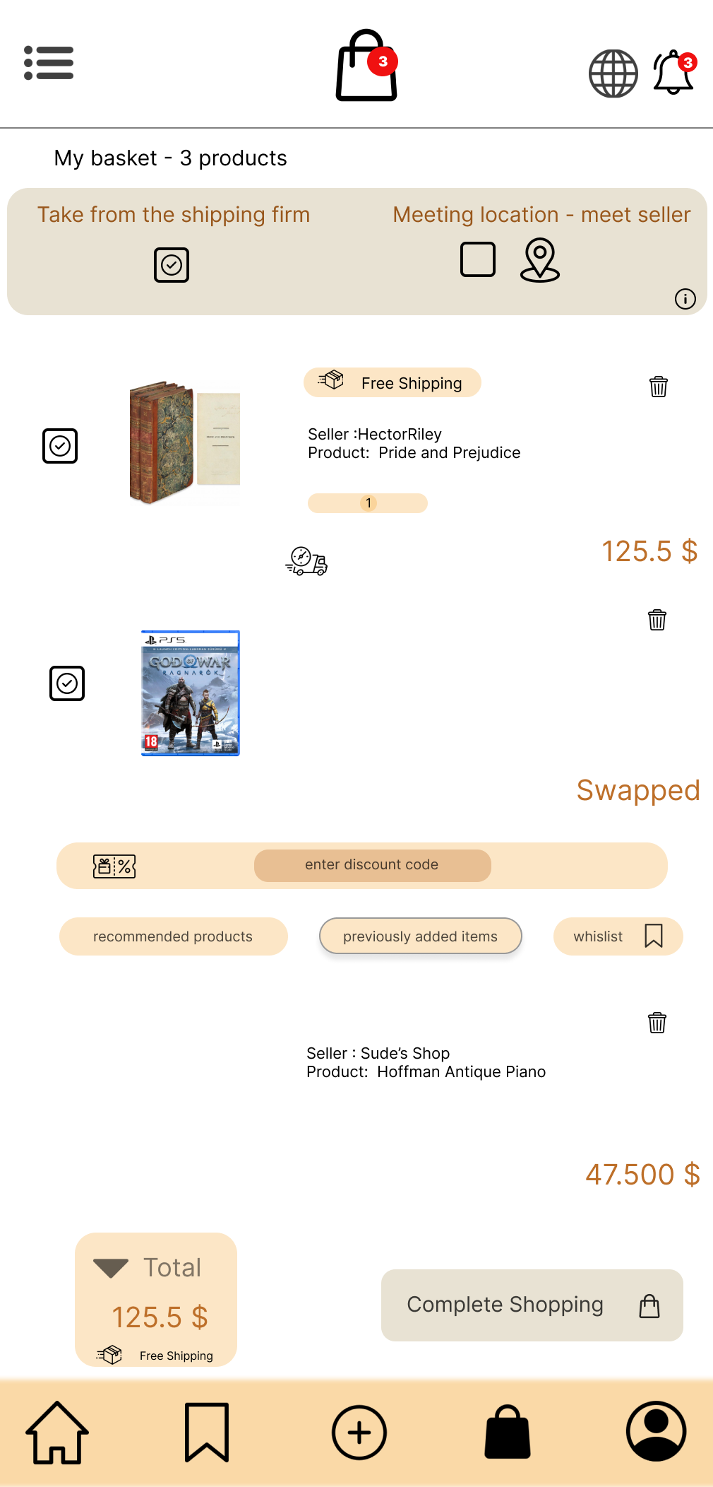
Error Prevention
Error Prevention - revised

Slide 17

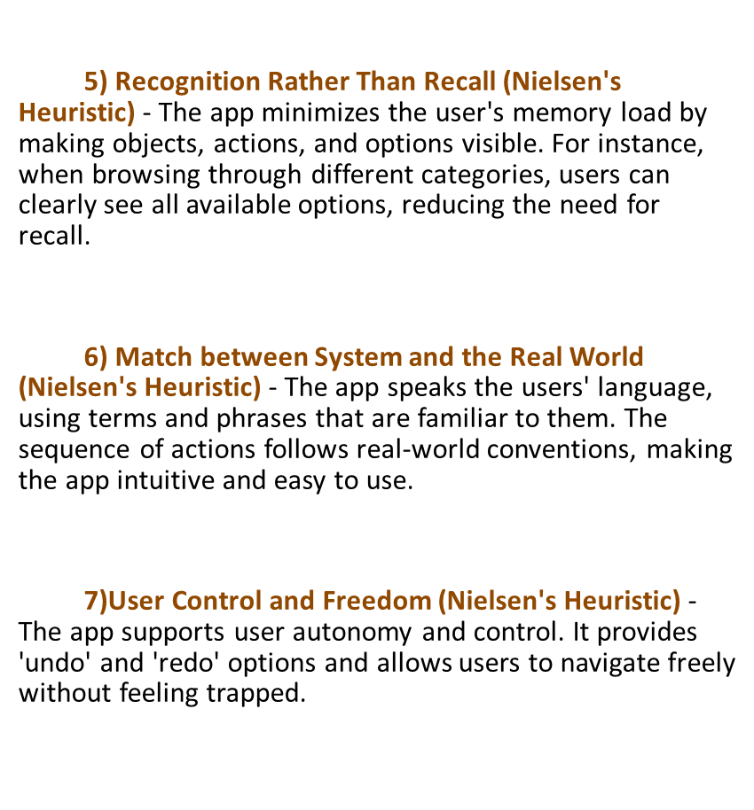
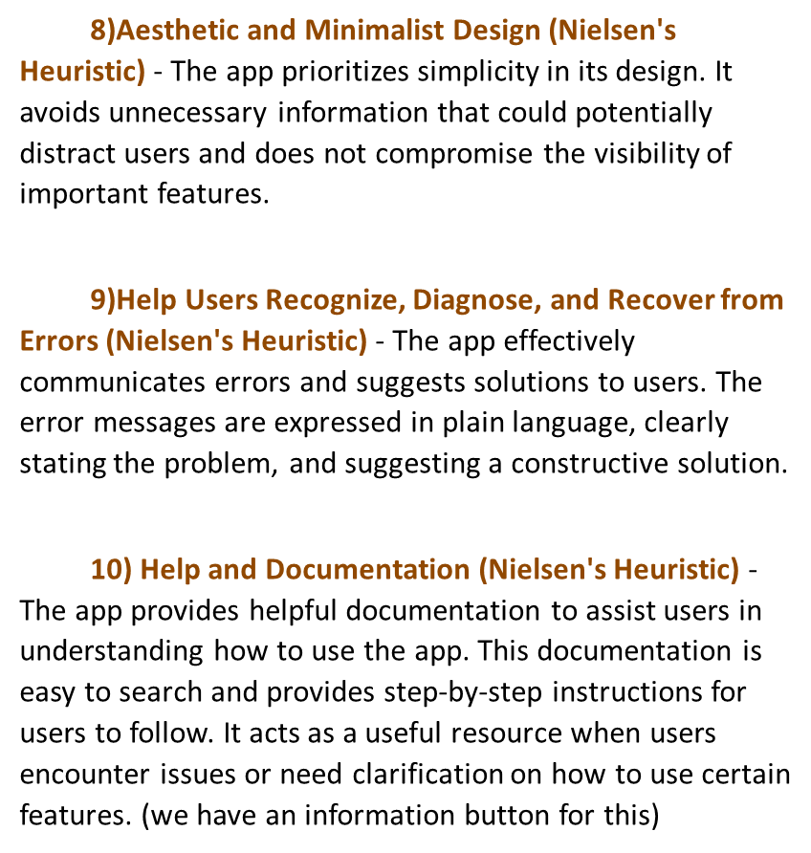


Slide 18

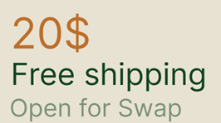
Additional Functionality: Message Screen for Swap
The most important feature that should be underlined in our application is the ability to exchange the products in their hands if an agreement can be reached between the users. Thanks to this budget-friendly, sustainable and ecological method, users need to communicate and agree with each other via messaging in order to exchange.

Slide 19
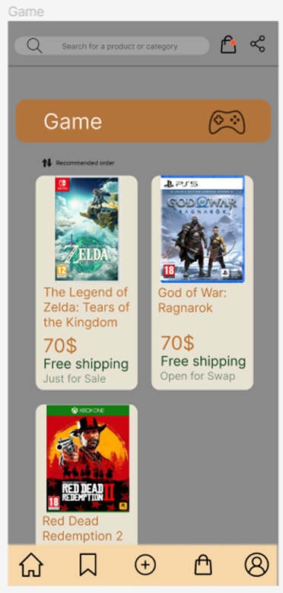
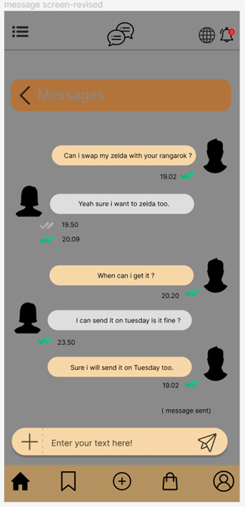

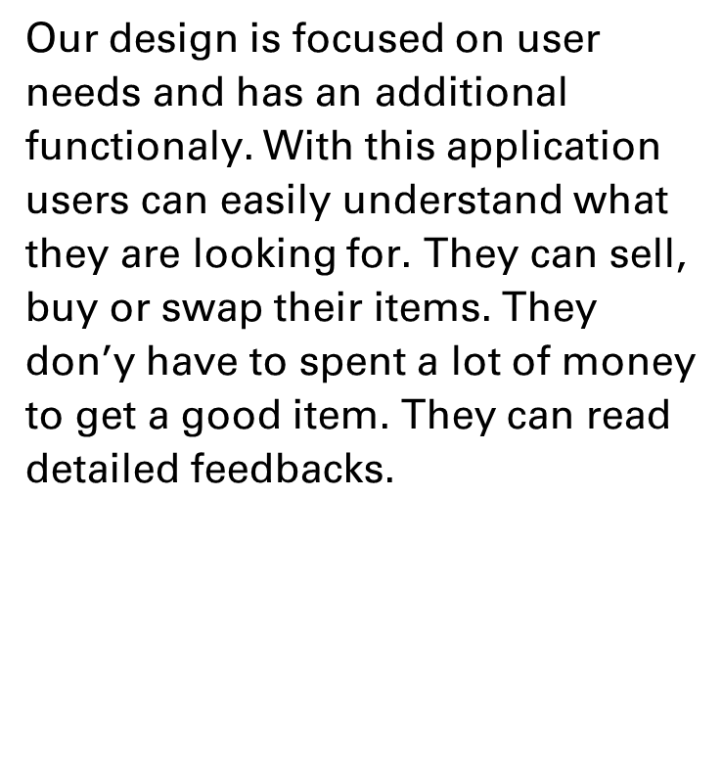

Slide 20


Team members
Ümmü Gülsüm Ergin - 1903022
Sude Naz Öğdem - 2002155
Ediz Özdil - 1906811
Mehmet Hisar - 1732118
Selin Çeçen - 1901919
Mehmet Girişken - 1901983

Slide 21



THANK YOU FOR LISTENING

